Slide 1


Noida Institute of Engineering and Technology, Greater Noida
Understanding Co-existence with other orders
Unit: IV
Understanding the human being comprehensively-Human Aspirations and its fulfillment
(KOE-069)
Shyam Lal Sharma
Assistant Professor
ME
B Tech (6th Sem)

Slide 2
CONTENT
Course Outcomes
CO-PO and PSO mapping
Unit -4 Syllabus
Unit -4 Objective, Prerequisite
Daily Quiz
MCQ
Weekly Assignment
Previous year Question papers
Expected Questions for University exam
Related Links for Unit -4
Summary

Slide 3
COURSE OUTCOME
At the end of the course, the student shall be able to
CO 1 | Student would be able to develop the clarity about human aspirations, goal, activities and purpose of life.
CO 2 | The clarity about Right Understanding could be possible for students.
CO 3 | Students would become competent to understand the harmony in nature/existence .
CO 4 | To help students in participating in the nature/existence.
CO 5 | To help the students to develop the understanding of human tradition and its various components.

Slide 4
CO-PO AND PSO MAPPING
CO – PO Mapping
Course Outcome | PO 1 | PO 2 | PO 3 | PO 4 | PO 5 | PO 6 | PO 7 | PO 8 | PO 9 | PO 10 | PO 11 | PO 12
CO 1 | 1 | - | 1 | - | 1 | 2 | 2 | 3 | 3 | 2 | 1 | 3
CO 2 | - | - | 1 | - | 1 | 2 | 1 | 3 | 3 | 3 | 2 | 3
CO 3 | 1 | - | 1 | - | 1 | 2 | 2 | 3 | 3 | 3 | 2 | 3
CO 4 | 1 | - | 1 | - | 1 | 2 | 2 | 3 | 3 | 3 | 2 | 3
CO 5 | 1 | - | 1 | - | 1 | 2 | 2 | 3 | 3 | 3 | 2 | 3
CO – PSO Mapping
CO | PSO1 | PSO2 | PSO3 | PSO 4
CO 1 | 1 | 1 | 1 | 1
CO 2 | 1 | 1 | 1 | 1
CO 3 | 1 | 2 | 1 | 1
CO 4 | 1 | 2 | 1 | 1
CO 5 | 1 | 1 | 1 | 1

Slide 5
UNIT-4 SYLLABUS
    TOPICS
Human Desire & its fulfillment(through self-exploration, self awareness and self-evaluation)
Right understanding, Knowledge of Existence
Co-existence Expressing itself in the form of Nature
Understand & live in Co-existence
Awakening to activities of the Self: (Realization of Co-Existence),
Understanding of Harmony in Nature and Contemplation of Participation of Human in this harmony/ order leading to comprehensive knowledge about the existence)
Knowledge of Existence –Harmony, Knowledge of Human Being

Slide 6
UNIT -4
Objective of the unit:
Understanding Co-existence with other orders. The need and the process of inner evolution (through self-exploration, self-awareness and self-evaluation)- particularly awakening to activities of the Self: Realization, Understanding and Contemplation in the Self.
Pre-requisite:
Student should be familiar to concepts right understanding, harmony, Human being as an Existence, co-existence of self and the body, Higher Activities of the self and Awakening of higher Activities, guiding the lower activities of the self.

Slide 7
Prerequisite to Topic 1
Prerequisites
Students should have to understand right understanding &natural acceptance. Students should have to follow self exploration and its process. Students should have to realize existence is ever present.

Slide 8
Introduction to Topic 1
Name of Topic | Objective of Topic | Mapping with CO
Existence as Co-existence | Students will be able to understand Existence, &Co-existence with right understanding | CO4

Slide 9
Human Desire & its Fulfillment (CO4)
1. Human Desire = Continuous Happiness
2. Continuous Happiness = Right Understanding
Right Feeling & Right Thought
CLARITY OF (Resolution )
3. Resolution 3.1. Right Understanding
3.2. Wisdom (Identification of Human Goal)
3.3. Science (How to fulfill Human Goal)
3.4. Behaviour
3.5. Work
3.6. Participation in Larger Order
3.7. Undivided Human Society
3.8. Universal Human Order
3.9. Human Tradition (in which Human Goal is fulfilled)
Need of the Self(I)
Activity of the Self(I)
Congruence?
Is Human Goal Fulfilled?

Slide 10
Right Understanding(CO4)
To see the reality as it is
Knower – [Self (I)]
To be Known – [Existence]
Process –
Awakening to activity of Contemplation, Understanding & Realisation
  Natural Innateness Co-existence
  Characteristic
3.1.1. Knowledge of Human Being
3.1.2. Knowledge of Existence
3.1.3. Knowledge of Human Conduct
3.1.2. Knowledge of Existence

Slide 11
Knowledge of Existence(CO4)
Existence = Co- Existence = Units submerged in Space
Unit
  1. Energised in Space
  2. Self organised in Space
  3. Recognises it's relationship,
  Fulfills its relationship with every other Unit in Space
Existence = All that exists
Self Organised = Is in a definite order, is in harmony, has definite conduct. Therefore it can be identified, understood

Slide 12
Knowledge of Existence (CO4)
¾ Co-existence
Existence
Ever Present
Units Submerged in Space
Limited in Size Unlimited All Pervading
Activity, Active No Activity
Material Consciousness
Recognising, Knowing, Assuming,
Fulfilling Recognising, Fulfilling
Ever
Temporary Continuous Unbounded in Time
& Space

Slide 13
Knowledge of Existence(CO4)
Time Bounded Unbounded Unbounded
Size / space Limited Limited Unlimited
Material Consciousness Space
Temporary Continuous Ever
Activity Activity No Activity
Body Self (I) Space
Sensation
Physical Facility
Impermanent "Permanent" Permanent
in time in time & space

Slide 14
Daily Quiz
____________ means physical facilities more than to satisfy my needs.
  Answer: prosperity
Self and ______________ are different in nature, materiality, needs and activities.
  Answer: body
Any entity that has the activity of recognizing and fulfillment only can be called as _________.
  Answer: material entity
Based on the taste, the ______could be triggered.
  Answer: thoughts
In I (self), recognizing and fulfillment depends on ____________.
  Answer: assuming

Slide 15
Recap of Topic 1
Existence = Co- Existence = Units submerged in Space.
All units are Energised in Space ,Self organised in Space& Recognises it's relationship, Fulfills its relationship with every other Unit in Space.
Space is Ever Present ,Unlimited All Pervading &No Activity.

Slide 16
Prerequisite to Topic 2
Prerequisites
Students should have to studied four orders of nature. Students should have to realize existence is ever present Students should have to understand right understanding &natural acceptance. Students should have to follow self exploration and its process.

Slide 17
Introduction to Topic 2
Name of Topic | Objective of Topic | Mapping with CO
Co-existence expressing itself in the form of Nature | Students will be able to live right understanding after understanding existence & also understand units & space. | CO4

Slide 18
Co-existence Expressing itself in the form of Nature (CO4)
Existence = Co-existence = Units submerged in space
Co-existence is ever present in all time, in all space
Co-existence is ever effective
Co-existence is ever-present
Every unit is energized, active
" " " self-organized " recognizes its relationship with other units and fulfills it .

Slide 19
Co-existence Expressing itself in the form of Nature (CO4)
This Co-existence is ever expressing In the form of 4 orders
Physical Order, Bio Order, Animal Order and Human Order
Physical Order-from atom to heavenly bodies
Bio Order -from cells to human body
Animal Order-Self awakened to selecting/tasting
Human Order-Self awakened to selecting/tasting, Analysing,
Imaging… need to know & potential to know

Slide 20
Existence (CO4)
Existence
(= Co-existence = Units submerged in Space)
Units (Nature)
Space (All-pervading)
Limited in size
Unlimited
Activity
No activity
Self-organized
Self-organization is available
Energized
Energy in equilibrium
Recognises the relationship and fulfills
Transparent
Material
Consciousness
Temporary
Self (I)
Continuous
Recognising, Fulfilling
Knowing, Assuming, Recognising, Fulfilling
Development fodkl
Not Cyclic
Physical Order
Bio Order
+
Animal Order
Atom
Cell
+
Molecule
Plant
Human Order
Activity Completeness
Molecular Structure
Animal Body
Right Understanding
Lump
Fluid
Human Body
Living with Right Understanding, Right Feeling & Right Thought
Cyclic
Composition – Decomposition
Conduct Completeness (Definite Human Conduct)

Slide 21
Daily Quiz
_________ means our ability to do or perform.
  Answer- Competence
Happiness and Prosperity are the two basic human desires.
a) True
b) False
The needs of the self are variable with time or place or people.
  a) True
  b) False
_________ Assuming without knowing.
  Answer- Preconditioning
________ taste of sound, touch, sight, taste, smell,
  Answer- Sensation

Slide 22
Recap of Topic 2
Co-existence is ever expressing In the form of 4 orders -Physical Order, Bio Order, Animal Order and Human Order.
Co-existence is ever effective
Co-existence is ever-present

Slide 23
Prerequisite to Topic 3
Prerequisites
Students should have to understand and activate all activities of self. Understand clearly what is the goal of human being. Students should have to realize existence is ever present Students should have to understand right understanding &natural acceptance. Students should have to follow self exploration and its process.

Slide 24
Introduction to Topic 3
Name of Topic | Objective of Topic | Mapping with CO
Role of Human Being in this Ever-expressive Co-existence | Students will be able to live right understanding what is my role in this existence and To ensure the feeling, thought of co-existence | CO4

Slide 25
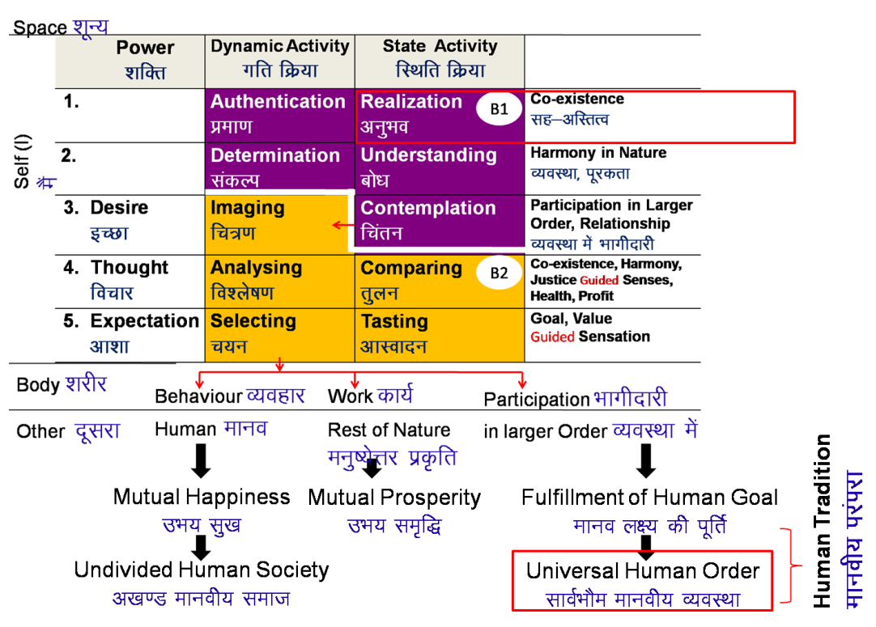
Existence
Existence
(= Co-existence = Units submerged in Space)
Universal Order
Units (Nature)
Space (All-pervading)
Limited in size
Unlimited
Activity
No activity
Self-organized
Self-organization is available
Energized
Energy in equilibrium
Recognises the relationship and fulfills
Transparent
Material
Consciousness
Development
Not Cyclic
Temporary
Self (I)
Continuous
Recognising, Fulfilling
Knowing, Assuming, Recognising, Fulfilling
Physical Order
Bio Order
+
Animal Order
Atom
Cell
+
Molecule
Plant
Human Order
Activity Completeness
Molecular Structure
Animal Body
Right Understanding
Lump
Fluid
Human Body
Living with Right Understanding, Right Feeling & Right Thought
Cyclic
Composition – Decomposition
Conduct Completeness (Definite Human Conduct)

Slide 26
Existence (CO4)
What is my role in Existence?
Existence based human centric contemplation
1 2 3
Contemplation of role of Human Being in Existence (which is the base)
3 2 1

Slide 27
To understand the co-existence(CO4)
  To understand what is co-existence – Knowledge
  To ensure the feeling, thought of co-existence – Resolution

Slide 28
To Live in co-existence (CO4)
  To live in relationship with human-beings
  –family to world family – - Undivided Society
  To live in co-existence in nature
  –family order to world family order – Universal Human Order

Slide 29
Self-exploration (CO4)
What is my role in Existence?
Existence based human centric contemplation
1 2 3
Contemplation of role of Human Being in Existence (which is the base)
3 2 1

Slide 30
Daily Quiz
Comprehensive human goal is right understanding, prosperity, fearlessness and ________.
(a) Mutual fulfilment (b) Natural Acceptance
(c) Mutual prosperity (d) Co-existence
2. The course inputs for human values need not to be verifiable. (True/False)
3. Sanyam leads to swasthya and swasthya leads to sukh. (True/False)
4. The ‘I’ is the doer, sear and enjoyer. (True/False)
5. There is an inherent inter connectedness, self regulation and harmony at all levels of existence and this needs to be discovered by each individual. The whole existence is coexistence. Humans are only a constituent part. (True/False)

Slide 31
Recap of Topic 3
Role of human being in existence is Existence based human centric contemplation.
To live in relationship with human-beings form Undivided Society.
To live in co-existence in nature to follow and live in Universal Human Order.
Discussed about knowledge & Resolution.

Slide 32
Prerequisite to Topic 4
Prerequisites
Students should have to know self exploration and its process. Students should have to activate all activities of self & live accordingly. Students should have to know right understanding. Students should have to know natural acceptance. Have to know As a human being what is my responsibility. Understand 4 orders.

Slide 33
Introduction to Topic 4
Name of Topic | Objective of Topic | Mapping with CO
Expression of Co-existence in Nature – the Four Orders | Students will be able to understand & live with other orders as a responsibility. | CO4

Slide 34
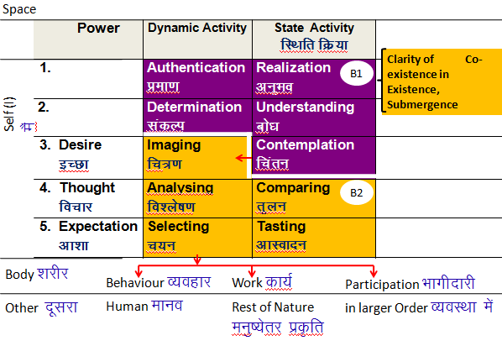
Knowledge of Human Being –
Activities of Self (I) (CO4)

Slide 35
Nature = Collection of Units = 4 Orders(CO4)
The presence of Self (I) is
indicated by the presence
of the activity of Assuming
To understand the other three orders, right understanding of the Human Order is required,
otherwise over-evaluation, under-evaluation or otherwise-evaluation of the other orders keeps taking place.
Recognizing, Fulfilling
Bio Order
Plants, Trees
Assuming,
Recognizing, Fulfilling
Recognizing, Fulfilling
Physical Order
Soil, Metal
Animal Order
Animals, Birds
Self (I) +
Body
Human Order
Human Being
Assuming,
Recognizing, Fulfilling
Potential for Knowing, Assuming,
Recognizing, Fulfilling
Self (I) + Body

Slide 36
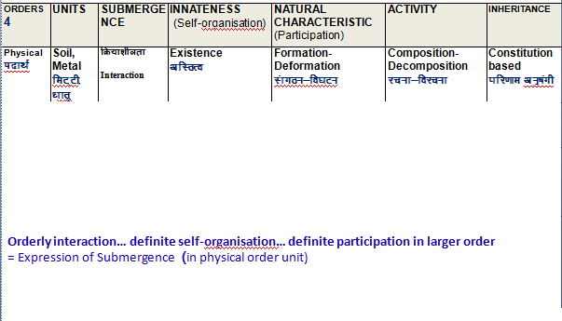
Nature = Collection of Units = 4 Orders(CO4)
Physical order

Slide 37
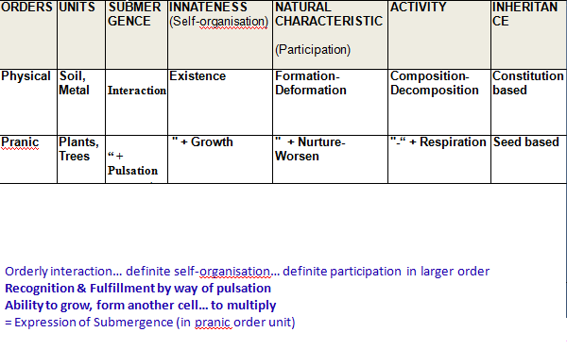
Nature = Collection of Units = 4 Orders(CO4)
Pranic Order

Slide 38
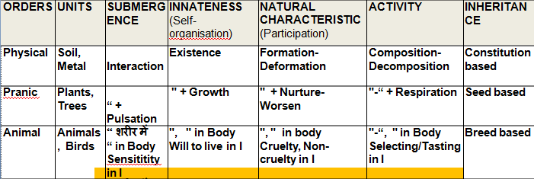
Nature = Collection of Units = 4 Orders (CO4)
Animal Order
In BODY
Orderly interaction… definite self-organisation… definite participation in larger order
Recognition & fulfillment by way of pulsation
Ability to grow, form another cell… to multiply
In SELF
Sensitivity toward sound, touch, sight, taste, smell
Recognition & fulfillment on basis of assuming based on breed
= Expression of Submergence (in animal order unit

Slide 39
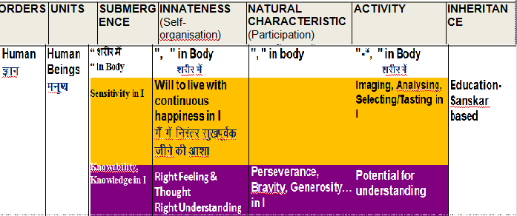
Nature = Collection of Units = 4 Orders(CO4)
Human Order
In BODY
Orderly interaction… definite self-organisation… definite participation in larger order
Recognition & fulfillment by way of pulsation
Ability to grow, form another cell… to multiply
In SELF
Sensitivity toward sound, touch, sight, taste, smell
Need to know and potential for knowing
Recognition & fulfillment on bas of knowing assuming. Need to know and potential for knowing
= Expression of Submergence (in human order unit)

Slide 40
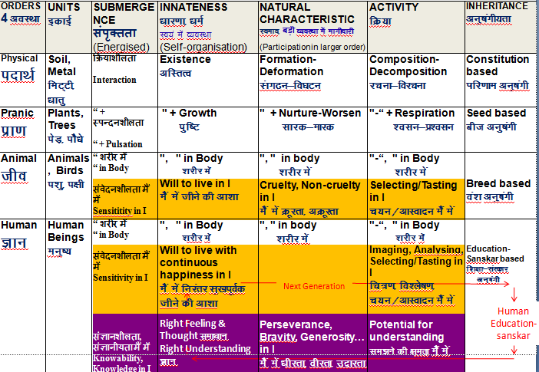
Co-existence(CO4)

Slide 41
Daily Quiz
The activities in human body are Composition/ decomposition and ______.
In animals only the activity of _________ is predominant.
__________ is equivalent to the natural world, physical world or material world.
The natural characteristic of material order _________.

Slide 42
Recap of Topic 4
Right understanding is -To see the reality as it is, in it's completeness (Knowing).
To facilitate the innateness (or at least not violate it) of all 4 orders.
To ensure the inheritance (or at least not violate it) of all 4 orders
Preservation (enrichment, protection and right utilization) of rest of nature.
To understand the other three orders, right understanding of the Human Order is required, otherwise over-evaluation, under-evaluation or otherwise-evaluation of the other orders keeps taking place.
Discussed about submerge, innateness, natural characteristics & activity & inheritance of 4 orders.

Slide 43
Prerequisite to Topic 5
Prerequisites
Students should have to know What is happiness & prosperity. Students should have to know self exploration and its process. Students should have to activate all activities of self & live accordingly. Students should have to know right understanding. Students should have to know natural acceptance. Have to know As a human being what is my responsibility. What is my role as a human being.

Slide 44
Introduction to Topic 5
Name of Topic | Objective of Topic | Mapping with CO
Fulfilment of this Role leads to Continuous Happiness | Students will be able to live with definite human conduct i.e continuous in harmony. | CO4

Slide 45
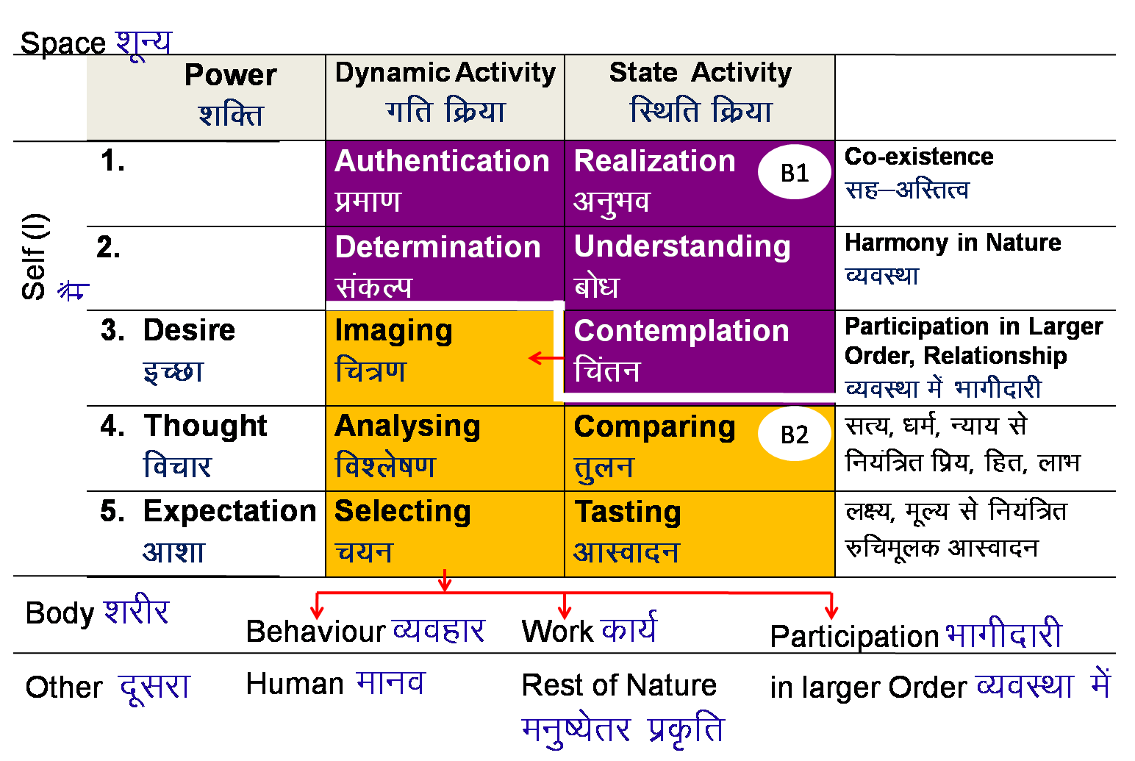
Fulfilment of this Role leads to Continuous Happiness (CO4)
Realization- within
Human Tradition
Mutual Happiness
Mutual Prosperity
Fulfillment of Human Goal
Expression- outside
Undivided Human Society
Universal Human Order

Slide 46
Fulfilment of this Role leads to Continuous Happiness (CO4)
vuqHko& Lo;a esa
Realization- within
Bliss
Satisfaction
Peace
Happiness
Human Tradition
Mutual Happiness
Mutual Prosperity
Fulfillment of Human Goal
Expression- outside
Undivided Human Society
Universal Human Order

Slide 47
Existence (CO4)
Existence
(= Co-existence = Units submerged in Space)
Universal Order
Units (Nature)
Space (All-pervading)
Limited in size
Unlimited
Activity
No activity
Self-organized
Self-organization is available
Energized
Energy in equilibrium
Recognises the relationship and fulfills
Transparent
Material
Consciousness
Development
Not Cyclic
Temporary
Self (I)
Continuous
Recognising, Fulfilling
Knowing, Assuming, Recognising, Fulfilling
Physical Order
Bio Order
+
Animal Order
Atom
Cell
+
Molecule
Plant
Human Order
Activity Completeness
Molecular Structure
Animal Body
Right Understanding
Lump
Fluid
Human Body
Living with Right Understanding, Right Feeling & Right Thought
Cyclic
Composition – Decomposition
Conduct Completeness (Definite Human Conduct)

Slide 48
Knowledge of Existence – Harmony(CO4)
ORDERS 4 | UNITS | ACTIVITY | INNATENESS (Self-organisation) | NATURAL CHARACTERISTIC (Participation) | INHERITANCE
Physical | Soil, Metal | Formation - Deformation | Existence | Composition-Decomposition | Constitution based
Bio | Plants, Trees | "-“ + Respiration | " + Growth | " + Nurture-Worsen | Seed based
Animal | Animals, Birds | "-“, " in Body Selecting/Tasting in I | ", " in Body Will to live in I | ", " in body Cruelty, Non-cruelty in I | Breed based
Human | Human Beings | "-“, " in Body Imaging, Analysing, Selecting/Tasting in I Potential for Contemplation, Understanding & Realisation in I | ", " in Body Will to live with continuous happiness in I Right Feeling & Thought Right Understanding | ", " in body Perseverance, Bravity, Generosity… in I eS] | Education-Sanskar based
  ACTIVITY
  Energised in Space

Slide 49
Knowledge of Existence – Harmony(CO4)
ORDERS 4 | UNITS | ACTIVITY | INNATENESS (Self-organisation) | NATURAL CHARACTERISTIC (Participation) | INHERITANCE
Physical | Soil, Metal | Formation - Deformation | Existence | Composition-Decomposition | Constitution based
Bio | Plants, Trees | "-“ + Respiration | " + Growth | " + Nurture-Worsen | Seed based
Animal | Animals, Birds | "-“, " in Body Selecting/Tasting in I | ", " in Body Will to live in I | ", " in body Cruelty, Non-cruelty in I | Breed based
Human | Human Beings | "-“, " in Body Imaging, Analysing, Selecting/Tasting in I Potential for Contemplation, Understanding & Realisation in I | ", " in Body Will to live with continuous happiness in I Right Feeling & Thought Right Understanding | ", " in body Perseverance, Bravity, Generosity… in I eS] | Education-Sanskar based
  INNATENESS
  Self organised in Space

Slide 50
Knowledge of Existence – Harmony(CO4)
ORDERS 4 | UNITS | ACTIVITY | INNATENESS (Self-organisation) | NATURAL CHARACTERISTIC (Participation) | INHERITANCE
Physical | Soil, Metal | Formation - Deformation | Existence | Composition-Decomposition | Constitution based
Bio | Plants, Trees | "-“ + Respiration | " + Growth | " + Nurture-Worsen | Seed based
Animal | Animals, Birds | "-“, " in Body Selecting/Tasting in I | ", " in Body Will to live in I | ", " in body Cruelty, Non-cruelty in I | Breed based
Human | Human Beings | "-“, " in Body Imaging, Analysing, Selecting/Tasting in I Potential for Contemplation, Understanding & Realisation in I | ", " in Body Will to live with continuous happiness in I Right Feeling & Thought Right Understanding | ", " in body Perseverance, Bravity, Generosity… in I eS] | Education-Sanskar based
  NATURAL CHARACTERISTIC
  Recognises it's relationship,
  Fulfills its relationship with every other unit

Slide 51
Knowledge of Existence – Harmony(CO4)
ORDERS 4 | UNITS | ACTIVITY | INNATENESS (Self-organisation) | NATURAL CHARACTERISTIC (Participation) | INHERITANCE
Physical | Soil, Metal | Formation - Deformation | Existence | Composition-Decomposition | Constitution based
Bio | Plants, Trees | "-“ + Respiration | " + Growth | " + Nurture-Worsen | Seed based
Animal | Animals, Birds | "-“, " in Body Selecting/Tasting in I | ", " in Body Will to live in I | ", " in body Cruelty, Non-cruelty in I | Breed based
Human | Human Beings | "-“, " in Body Imaging, Analysing, Selecting/Tasting in I Potential for Contemplation, Understanding & Realisation in I | ", " in Body Will to live with continuous happiness in I Right Feeling & Thought Right Understanding | ", " in body Perseverance, Bravity, Generosity… in I | Education-Sanskar based
Next Generation
Human Education-sanskar

Slide 52
Knowledge of Human Being (CO4)
Space “kwU;
 | Power | Dynamic Activity | State Activity
1. |  | Authentication Áek.k | Realization vuqHko
2. |  | Determination ladYi | Understanding cks/k
3. | Desire | Imaging | Contemplation
4. | Thought | Analysing | Comparing
5. | Expectation | Selecting | Tasting
B1
Clarity of Harmony in Nature,
Self-organisation, Innateness
Self (I)
eSa
B2
Body
Behaviour
Human
Work
Rest of Nature
Participation
in larger Ordersa
Other

Slide 53
Knowledge of Human Being (CO4)
Space “kwU;
 | Power | Dynamic Activity | State Activity
1. |  | Authentication Áek.k | Realization vuqHko
2. |  | Determination ladYi | Understanding cks/k
3. | Desire | Imaging | Contemplation
4. | Thought | Analysing | Comparing
5. | Expectation | Selecting | Tasting
B1
Self (I)
eSa
Clarity of Relationship, Natural Characteristic,
Participation in Larger Order
Clarity of Relationship, Natural Characteristic,
Participation in Larger Order
B2
Body
Behaviour
Human
Work
Rest of Nature
Participation
in larger Ordersa
Other

Slide 54
Daily Quiz
__________ implies that each unit of the four orders is related to each other and enriching to each other.
There are two kind of realities in existence- _______ & _____.
The basic activities of plant order are __________.
There is already a basic harmony in nature everywhere. We just have to recognize it and live it.(True/False)
Working for right understanding as the first priority followed by relationship and physical facilities implies living with _________.

Slide 55
Recap of Topic 5
Fulfilment of Role of human being in entire existence leads to Continuous Happiness. This role fulfilled by activating the realization (activity of self).
Block B2 of self gives Clarity of Relationship, Natural Characteristic, Participation in Larger Order.
Block B21 of self Clarity of Harmony in Nature, Self-organisation, Innateness

Slide 56
Faculty Video Links, Youtube & NPTEL Video Links and Online Courses Details
Youtube/other Video Links
https://www.youtube.com/watch?v=nFAa4t1d0TA
https://www.youtube.com/watch?v=Cnw1nK3K5qk
https://www.youtube.com/watch?v=0CHNLEnZurs
https://www.youtube.com/watch?v=xl0XErERtUg&list=PLWDeKF97v9SP_Kt6jqzA3pZ3yA7g_OAQz&index=6

Slide 57
Weekly Assignment
Q.1- What is the Role of Human Being in this Ever-expressive Co-existence.CO4
Q.2-How the Co-existence express in Nature . What are the four orders of nature? Briefly explain them. CO4
Q.3- Explain the Innateness, natural characteristics and Inheritence. CO4
Q.4-What do you mean by realization within.CO4
Q.5-How will you show interconnectedness and mutual fulfilment in four order of nature with examples? CO4

Slide 58
MCQ s
The material units are transformable, and their composition keeps on changing, hence these are
(a) Gathansheel (b) Gathanpurna
(c) Kriyapurnata (d) Acharanpurnata
2. __________ implies that each unit of the four orders is related to each other and enriching to each other.
(a) Mutual Prospertity (b) Fulfillment
(c) Right Understanding (d) Mutual fulfillment
3. In space __________ is available.
(a) Self- organization (b) Self-regulation
(c) Right understanding (d) None of above

Slide 59
MCQ s
4. Conformance of material order is-
(a) Seed conformance (b)Breed conformance
(c) Constitutional conformance (d)None of above
5.In animals only the activity of _________ is predominant.
(a) Selection (b) Respiration
(c)Selection/Taste (d)None of these
6. ________ is Commitment for helping the other to understand harmony & to live in harmony at all 4 levels.
(a)Bravity (b)Wisdom
(c)Perseverence (d)All of these

Slide 60
Old Question Papers
https://abesit.in/library/download/B.Tech./Sem.7/2019-20/UNDERSTANDING-THE-HUMAN-BEING-COMPREHENSIVELY-KOE-069.pdf
https://abesit.in/library/download/B.Tech./Sem.3/2018-19/UNIVERSAL-HUMAN-VALUES-AND-PROFESSIONAL-ETHICS-RVE-301.pdf
https://abesit.in/library/download/B.Tech./Sem.3/2017-18/UNIVERSAL-HUMAN-VALUES-PROFESSIONAL-ETHICS-RVE-301.pdf

Slide 61
Expected Questions for University Exam
List the four dimensions of human being. 2 marks
Explain this statement- Self is central to human existence. 2 marks
How does the dimension of thoughts differ from the dimension of realisation? What is the process to activate this . 5 marks
Describe precisely how the imaging in the self gets transformed with contemplation. 3 marks
Personal transformation leads to social transformation evaluate this statement with example . 6marks
Define existence? Show that existence is in a form of co-existence. 5 marks
By understanding the human being is not just the body, but a co-existence of Self and Body, list some of the qualitative shifts in living of a human being. 5 marks

Slide 62
Summary
There is a relationship of mutual fulfilment amongst these 4 orders. So far, the first 3 orders are mutually fulfilling for each other as well as for human beings
It is naturally acceptable to human beings to be fulfilling for all the orders.
Human beings need to understand this mutual fulfilment; only with this understanding will human beings be able to live with mutual fulfilment.
Existence is in the form of co-existence. It is ever present
(Existence = Co- Existence = Units submerged in Space)
Every unit in existence is related with every other unit in existence in a mutually fulfilling manner

Slide 63
References
A Foundation Course in Human Values and Profession Ethics (Text Book and Teachers’ Manual), R. R. Gaur, R. Sangal, G. P. Bagaria (2010), Excel Books,New Delhi [ISBN 978-8-174-46781-2]
Avartansheel Arthshastra, A. Nagraj, Divya Path Sansthan, Amarkantak, India
Economy of Permanence – (a quest for social order based on non-violence), J.
C. Kumarappa (2010), Sarva-Seva-Sangh-Prakashan, Varansi, India
Slow is Beautiful, Cecile Andrews http://www.newsociety.com/Books/S/Slowis-Beautiful)

Slide 64
Thank You

